Slide 1

Redevelopment Commission
March 1, 2022
Madison Plaza Development

Slide 2
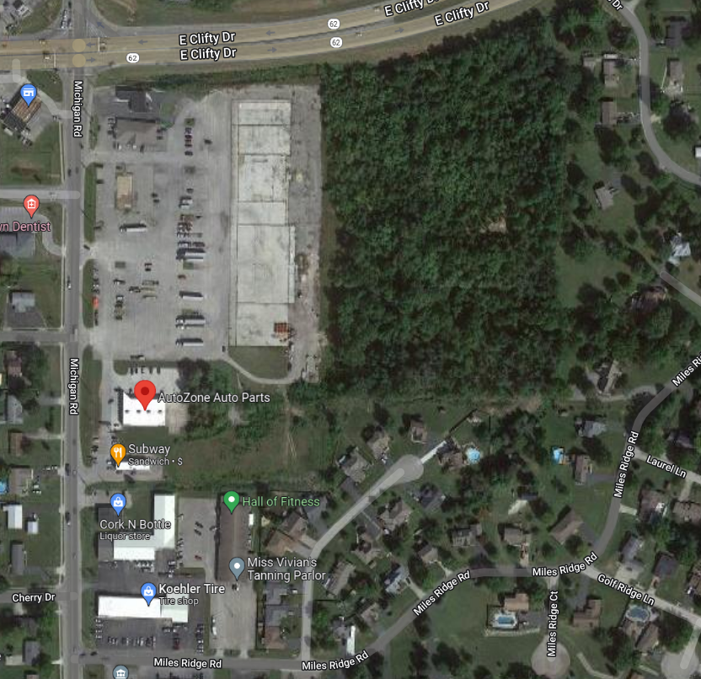






Madison Plaza Development
Blue: City Purchase
Yellow: Sell to Winterwood
Purple: Retail – CRM
Red: Plaza District Enhancements
Dark Blue: traffic Light

Slide 3
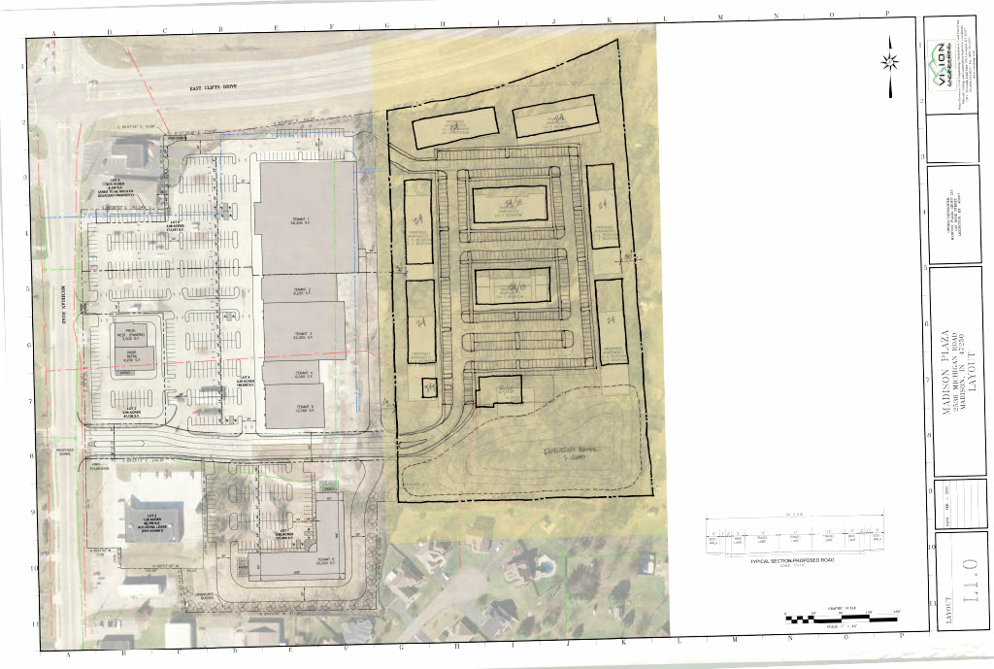

Slide 4
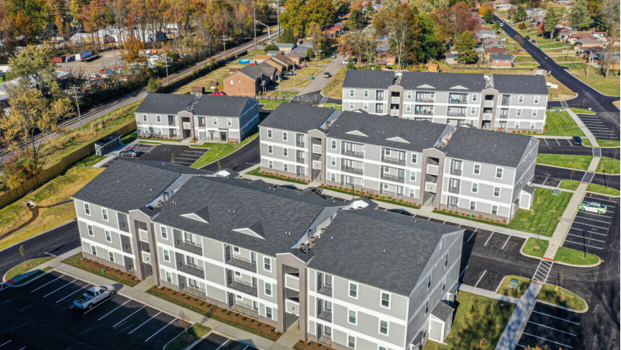

Slide 5
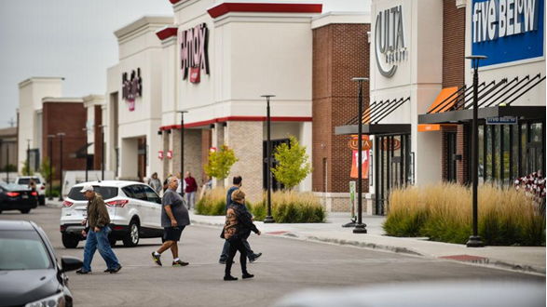

Slide 6
Plaza District Incentives and Enhancements
Land:
$1.2 Million
(Net: $500k)
Boulevard Construction: $1,000,000
(estimate)
Traffic Signal: $300,000
(estimate)
District Improvements and Enhancements: $500,000
(estimate)
Sewer Line:
$750,000
(estimate)
Professional Design Fees:
$150,000
(estimate)
TOTAL:
$4 M Construction/Incentives

Slide 7
Economic Development Agreement
Site Amenities (Public Art, Parks Etc)
Architectural Aesthetics
Time-lines
Min. Commitment By Developer

Slide 8

Development Schedule
1 Mar.
Approve both the Winterwood and CRM EDA’s at RDC Meeting
Presentations by both developers
1 Mar. – 1 June
Various City Approvals for Bonds associated with the development
June
Close on the property from CRM
1 Aug.
CRM begins construction
2022
Winterwood buys property from City and begins construction
Aug. 2023
RETAIL Center Opens
District Improvements Complete
Winterwood starts construction (residential)
Aug. 2024
Residential Opens

Slide 9
Investment
$36.5 Million Residential
$17.8 Million Retail
Total: $54.3 million
$4 Million City Investment (Incentive and Interest)
Return on Investment nearly 70% on the New Revenue

